Slide 1
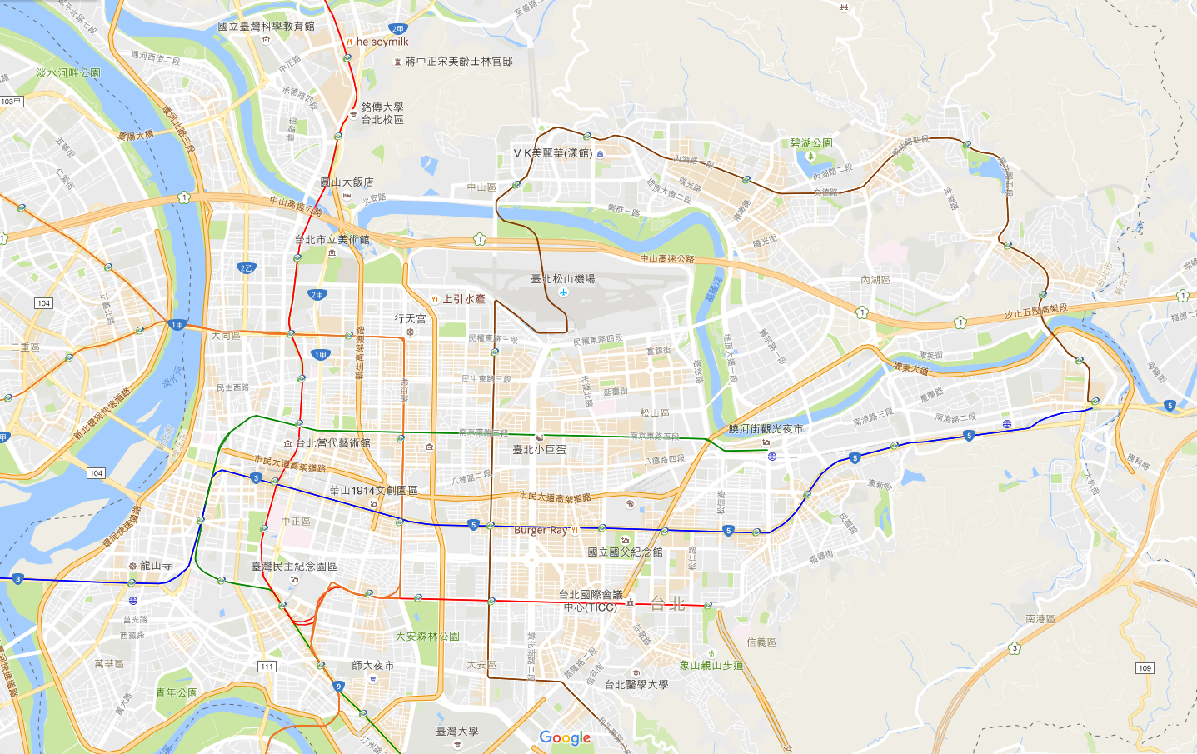
Innovation Startup Center Map
Operated
(10)
108
(2)
109
(2)
110
(1)
111
(3)
113~
(4)
Version：2018/11/03
Beitou-Shilin Technology Park 83,800/251,400㎡
base/floor Area
Wanbao Textile
Design Startup Hub
3,340/12,026 ㎡ base/floor Area
Taipei Co-Space
2,200㎡ floor area
Shilin Station
Gangqian Station
DigiBlock Taipei
5,919㎡ floor area
Fablab Taipei
Promotion Space
254㎡ floor area
t.Hub
17,542/115,710㎡
base/floor Area
Audi Accelerator
1,225 ㎡ floor area
Yuanshan Station
Minglun Public
Smart House
Startup Hub
1,945㎡ floor area
Tesla EIS Center
2,133㎡ floor area
Fashion Block Taipei
893㎡ floor area
Nangang Cap Factory
Self-Creater Platform
3,793 ㎡ floor area
Nangang Conference Center Digital Innovation Center
21,247㎡ floor area
CIT Co-working Space
2,233㎡ floor area
Ganghu Creative Research Center
22,436/78,354㎡ base/floor Area
Nangang Exhibition Center Station
Shintomicho
Cultural Market
658㎡ floor area
T Fashion
4,824㎡ floor area
AR1 1st Financial Technology Innovation Incubation Center
1272㎡ base/floor Area
Nangang Station
Taipei main Station
Nangang Depot
Biotechnology Innovation Research Center
5,336/61,000㎡ base/floor Area
Zhongxiao Base
Nangang Biotechnology
Industry Hub
15,097/60,972㎡ base/floor Area
Fuxing Public
Smart House
Startup Hub
929㎡ floor area
AR1 2ed Industry Incubation Center
4000㎡ base/floor Area
Houshanpi
Station
Longshan Temple Station
Tongan Market Startup Hub
499 ㎡ floor area
22place
The number of bases
10place
operated
633,486 Square meter
Total floor area(191,630㎡ )

